Slide 1
Income Tax Assistance Volunteer Training
Tax Year 2024
Notes:
Welcome to the Income Tax Assistance Volunteer Training for Tax Year 2024. I am (enter name), the (Title) for the (Division) at the New York State Department of Taxation and Finance. I am pleased to be presenting you this training. I would like to start by letting all of you know how valued you are to our Department. Your assistance to those taxpayers that need it most, through tax preparation and other financial literacy services, is essential to the communities you serve and to New York State as a whole. Our goal is to make sure you have the information you need to help others so let’s review our agenda.

Slide 2
Efficiency: Compliance Continuum
Our mission:
To efficiently collect tax revenues in support of state services and programs, while acting with integrity and fairness in the administration of the tax laws of New York State.
Notes:
Some of you may have seen this Compliance Continuum slide in the past. It shows how actions can be taken by both taxpayers and the Department which enable us to be more efficient. These actions on the left side of the continuum like proposing legislation, publishing clear guidance and instructions, and, for taxpayers, filing their returns and making payments timely, also cost both the taxpayers and Department less money. On the right side we have the more expensive and time-consuming things like audits, collections and litigation.
While the department will always have some activity on the right side of the continuum, the left is really where we have tried to focus on improvement opportunities.

Slide 3
Agenda
Partner and Volunteer Requirements
Partner and Volunteer Resources
New York State, New York City, and Yonkers Filing Information
Federal Income and Adjustments
Addition and Subtraction Modifications
Pensions and Annuities Examples
New York State Standard and Itemized Deductions
Notes:
In 2022 we reworked the volunteer training presentation to better match the flow of the New York State return.
You will notice we do not have a specific “what’s new” section. Instead, we added New icons to any pages that reflect brand new items and an updated icon to reflect sections that were updated for other items. As you can see from the agenda, we added more sections to explain the different areas of the New York return, so after we cover general volunteer resources we will then go to:
New York State Volunteer Requirements
Volunteer Resources
New York State Filing Requirements
New York State Income and Adjustments
New York State Modifications
New York State Standard and Itemized Deductions
New York State Credits
New York State Personal Income Tax Filing
Reminders
Tax Department Programs and Initiatives
We hope you like this new format, so let’s get started.

Slide 4
Agenda
New York State Tax Credits
Partner and Volunteer Filing Reminders
2024 Questions and Answers
Tax Department Notices and Protest Rights
Tax Department Programs and Initiatives
Notes:
In 2022 we reworked the volunteer training presentation to better match the flow of the New York State return.
You will notice we do not have a specific “what’s new” section. Instead, we added New icons to any pages that reflect brand new items and an updated icon to reflect sections that were updated for other items. As you can see from the agenda, we added more sections to explain the different areas of the New York return, so after we cover general volunteer resources we will then go to:
New York State Volunteer Requirements
Volunteer Resources
New York State Filing Requirements
New York State Income and Adjustments
New York State Modifications
New York State Standard and Itemized Deductions
New York State Credits
New York State Personal Income Tax Filing
Reminders
Tax Department Programs and Initiatives
We hope you like this new format, so let’s get started.

Slide 5
Partner and Volunteer Requirements

Slide 6
Partner and Volunteer Requirements
Federal requirements must be met
No additional New York State testing
Review volunteer training
Volunteer website: www.tax.ny.gov/volunteer
Notes:
As a volunteer filing NYS tax returns you are required to meet all the federal requirements. However, there are no additional requirements to meet for NYS. New York State does not have an additional test. If you don’t meet the Federal requirements to complete federal returns, you can’t file NYS tax returns.
What you will want to do is to fully review this training presentation and familiarize yourself with our volunteer website which we will cover in a minute.

Slide 7
Confidentiality Reminder
Taxpayers using volunteer program services provide personal information to the volunteers, such as names, addresses, social security numbers, birth dates, and bank account information.
Volunteers must keep all information confidential, safeguard it from unauthorized individuals, and prevent its misuse.
Notes:
This is just a reminder of something that is covered in your federal trainings, but it is extremely important to NYS as well. You will be looking at and working with a lot of personal information. Volunteers must keep all information confidential, safeguard it from unauthorized individuals, and prevent its misuse. We know if you passed the federal training that you are familiar with this rule, however it is so important in the world we live in today – we just wanted to remind you one more time.

Slide 8
E-file Mandate
All forms should be e-filed, either directly through software or by PDF attachment to the filing.
Volunteer preparers are not subject to e-file mandate.
New York State supports both linked and unlinked returns.
even if the IRS will not accept a return, the state return can be filed as an unlinked return
most software allows unlinked returns
Notes:
New York State has a Personal income tax e-file mandate. We support both linked and unlinked returns. Even if the IRS will not accept a return, the state return can be filed as an unlinked return. Most software allows unlinked returns. All forms can be e-filed, either directly through software or by PDF attachment to the filing.

Slide 9
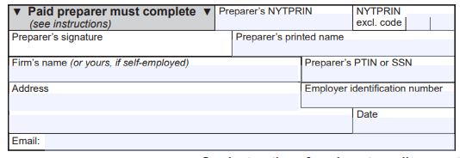
Volunteer Tax Preparer Signature
Tax returns should include the site name and exclusion code 09 (volunteer tax preparer)
Notes:
Volunteer tax preparers are not subject to the e-filing mandate. You should make sure to use the 09 - volunteer tax preparer code in your program.

Slide 10
Driver License Information Required
ID information is used to protect taxpayers from fraud and identity theft.
The document number for the primary taxpayer and spouse are required.
Only the first three characters of the document number (Doc #) are required.
If the taxpayer won’t disclose their ID information:
You may check the box to indicate the taxpayer does not have an ID.
You must document you used due diligence to obtain the information, and the taxpayer refused.
Notes:
Drivers license ID information is used to protect taxpayers from fraud and identity theft. The document number for the primary taxpayer and spouse are required. Only the first three characters of the document number are required. If the taxpayer won’t disclose their ID information, you may check the box to indicate the taxpayer does not have an ID; and you must document you used due diligence to obtain the information and the taxpayer refused.

Slide 11
Partner and Volunteer Resources
Access resources online

Slide 12
Partner and Volunteer Resources
www.tax.ny.gov/volunteer

Slide 13
Training Materials
Volunteer training 2024
Military personnel training
2024 Free Filing Assistance Volunteer Packet
Form TP-301, Income Tax Worksheet (2024)
Pension subtraction handout
Prior year’s training
Notes:
The Training Materials section includes all the training items that will help you throughout the season. Obviously, it houses this training and the recorded version; a military personnel training which has specifics for those serving in the military; a link to the materials in the 2024 free file assistance volunteer packet, The TP-301 updated for 2024, the pension subtraction handout which helps answer questions on how taxation of pensions work and finally a link to a page which houses all of our older training presentations.

Slide 14
Partner Resources: Tax Filer Information
www.tax.ny.gov/volunteer
Notes:
At the bottom of the page, you will find information for:
Active military personnel and veterans
Retired person and senior citizens
The self-employed, cash-earners and estimated tax filers. I’ll touch on this section more in the next slide as this will impact the STEP partners
Foreign language filers; and,
Information and link to contact TaxSlayer Volunteer Support

Slide 15
2024 Free Filing Assistance Volunteer Packet
IT-201, Full-Year Resident Income Tax Return packet for New York State, New York City, Yonkers, and MCTMT*
Form IT-196, New York Resident, Nonresident, and Part-Year Resident Itemized Deductions*
IT-225, New York State Modifications*
IT-195, Allocation of Refund
* with instructions
Notes:
The Free Filing Assistance Packet has the main forms in it that are needed for filing. We include the IT 201 packet that has NYS, NYC and MCTMT in it, then the IT-196 for itemized deductions, the IT-225 for New York state modifications and the IT-195 which allows taxpayers to allocate any refund they having coming to them. I will discuss this later in the presentation.

Slide 16
2024 Free Filing Assistance Volunteer Packet
IT-227, New York State Voluntary Contributions
IT-214, Claim for Real Property Tax Credit for Homeowners and Renters
NYC-210 and NYC-210-I, Claim for New York City School Tax Credit
DTF-215, The Earned Income Tax Credit - Recordkeeping Suggestions for Self-employed Persons
CO-309, How are you paid for your work and services?
Notes:
In addition to those forms, we have the IT-227 for voluntary contributions, the IT -214 Claim for real property tax credit for homeowners and renters, and the NYC-210 Claim for the New York City School Tax Credit.
We also include some informational items, the DTF-215 Earned income tax credit- recordkeeping suggestions for self-employed persons and the CO-309 how are you paid for your work and services? These item are great to hand out to taxpayers who are not sure what they should keep for their tax records when they are self-employed.
While we mail out the packets these materials can be printed from the free filing assistance volunteer packet page as well.

Slide 17
Request Packets and Forms
Request packets and forms no later than December 20, 2024
Contact: taxpartners@tax.ny.gov
Your name, email, and address (physical addresses only, no PO boxes)
Number of 2024 Free Filing Assistance Volunteer Packets (5 maximum)
Form type and quantity (TP-301, NYC-208, and NYC-210 only)
Materials will ship no later than the week of January 13, 2025
Notes:
If you are looking for these packets to be mailed, you should have sent those requests in already as we were looking for them by December 20, 2024. the Include
your name, email, and mailing address (no P.O. boxes!);
the number of packets you need (no more than 5); and
any other forms and how many.
Packets will ship no later than the week of January 13, 2025

Slide 18
TP-301, Income Tax Worksheet
Provides guidance on income, expenses, deductions, and credits that do not automatically carry over from the federal return:
New York State additions and subtractions
New York State only credits
Pension exclusions
New York State, New York City, and Yonkers residency
Notes:
The TP-301 is the intake questionnaire that provides guidance on income, expenses, deductions and credits that do not automatically carry over from the federal return:
New York State additions and subtractions
New York State only credits
pension exclusions
New York State, New York City, and Yonkers residency questions
We had a few updates on the TP-301 for this year. We added School district back and added 529 saving to the qualify education.

Slide 19
TP-301, Income Tax Worksheet Updates
IT-229, Real Property Tax Relief Credit, was discontinued and this credit is no longer available.
Notes:
IT-229, Real Property Tax Relief Credit, was discontinued.

Slide 20
Partner Resource Forms and Publications
You can download and print forms and publications from our website: www.tax.ny.gov/volunteer
Certain documents are available in languages other than English (search: language access)
If necessary, limited additional quantities of some forms can be mailed to you during the filing season. Order materials by sending an email to NYStax.SpecReq@tax.ny.gov
Notes:
Other resources available to you can be found on our website, like forms and publications. You can also get many documents in other languages. In addition, limited additional quantities of some forms can be mailed to you during the filing season. Order by sending an email to NYStax.SpecReq@tax.ny.gov.

Slide 21
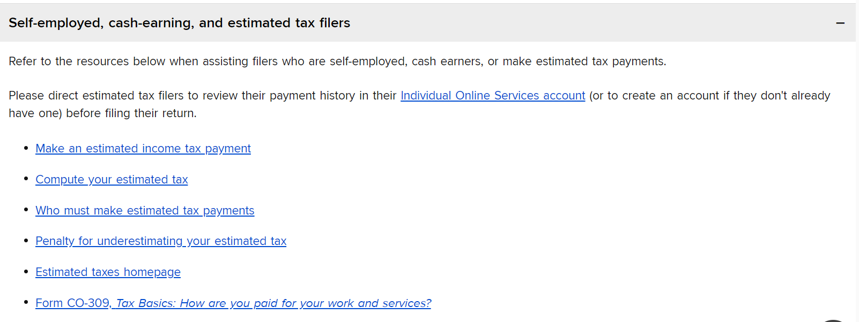
Partner Resources: Self-employed Filers
Notes:
Approved SETP slide:
This section has a great deal of information to assist you with filers who are self-employed, cash earners, or those who may need to make estimated tax payments:
Make an estimated income tax payment
Compute your estimated tax
Who must make estimated tax payments
Penalty for underestimating your estimated tax
Estimated taxes homepage
Form CO-309, Tax Basics: How are you paid for your work and services

Slide 22
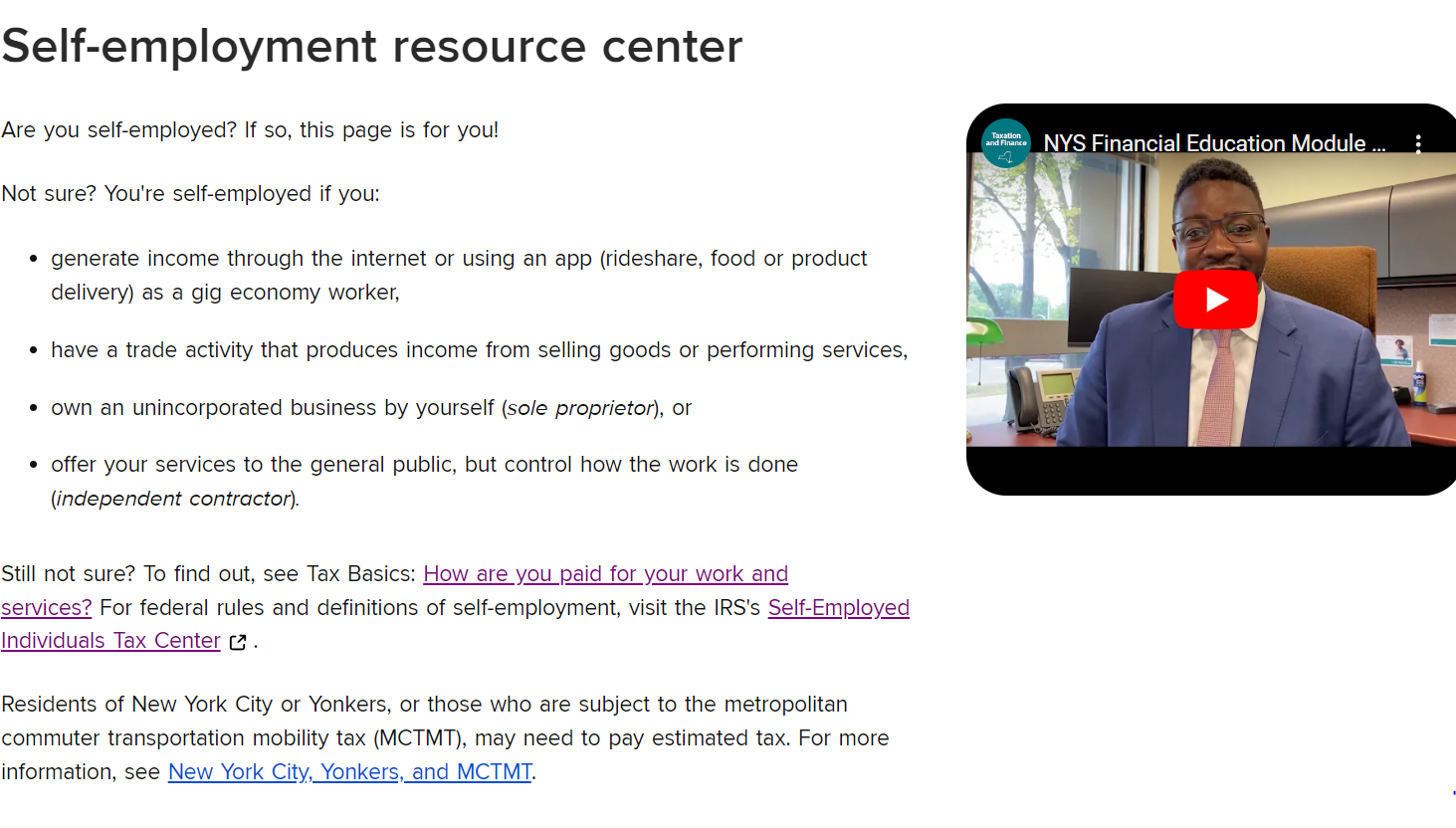
Self-employment Resource Center
www.tax.ny.gov (search: self-employment)
Notes:
Approved SETP slide:
Other resources include the self-employed resource center. On the self-employed resource center page, you can find information:
For self-employed individuals – with not employees and self-employed with employees
How to manage your documentation, see Recordkeeping for businesses and Recordkeeping for individuals; and,
Our monthly income and deductions worksheet, Deduction tracker.

Slide 23
Recordkeeping
www.tax.ny.gov (search: self-employment)
Notes:
Approved SETP slide:

Slide 24
Tax Professional Hotline
518- 457-5451
Available to professionals and volunteers
provide the name of your VITA or TCE site
Limited or no wait time
Experienced staff to answer more technical questions
Notes:
Another great resource to you is the Tax professional hotline. Many of you have this number, but I want to reiterate that this number is a dedicated hotline only for you!
So if you haven’t written it down, please do so now.
Average wait time to speak to a representative is 2 minutes
Staff are experienced and equipped to handle your technical questions
Its IMPORTANT to remember!
“Do not give the Tax Professional Hotline number to your clients! The staff on this line will not assist your clients and they’ll be transferred to the appropriate phone number.”

Slide 25
2024 Filing and Payment Due Date
Tuesday, April 15, 2025
Notes:
Taxpayers will have until April 15, 2025 to file their 2024 and pay amounts owed. Taxpayers may request a 6 months extension by filing Form IT-370 and paying any tax due, on or before this due date.

Slide 26
New York State, New York City, and Yonkers Filing Information
Notes:
Now that you know where to find resources, let’s get into the New York State return.

Slide 27
Summary of NYS Income Tax Return
Federal Adjusted Gross Income
(FAGI)
Adjustments to income
Federal Adjusted Gross Income
New York additions and subtractions
New York Adjusted Gross Income (NYAGI)
Standard or New York Itemized Deductions
NY Taxable Income
Credits
Notes:
Once you know if a taxpayer is a resident or not and that they need to file here is the general flow of the New York State tax return. The New York Return is based off of the federal return with adjustments and modifications. The flow starts with the same income items from the Federal Return that you put in Federal Adjusted Gross Income, but we have adjustments to that income to give you the federal adjusted gross income. From there we have New York specific additions and subtractions to arrive at New York Adjusted Gross Income. We then deduct a New York standard deduction or New York itemized deduction to arrive at NY taxable income. Taxable income is used to compute the tax which is further reduced by tax credits.
We will now go through each section highlighting where we are unique.

Slide 28
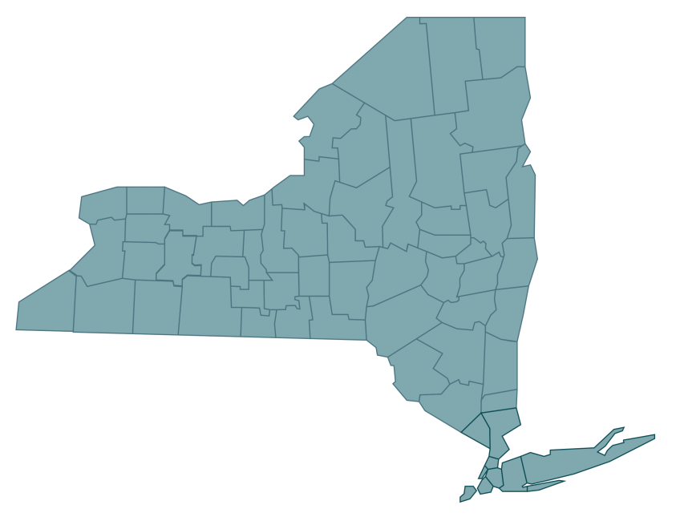
New York State Residency
When filing a personal income tax return, a taxpayer must determine which one of three New York State residency statuses applies:
Resident,
Nonresident, or
Part-year resident.
Notes:
When filing a New York state return the first thing you must determine is residency. You need to know if the taxpayer Is a resident, non-resident, or part-year resident.

Slide 29
New York State Resident Filing Requirements
Taxpayers must file a New York State resident return if:
they’re required to file a federal return;
they’re not required to file a federal return but their federal adjusted gross income plus New York additions is more than $4,000 ($3,100 or more if the taxpayer is single and can be claimed as a dependent on another taxpayer’s federal tax return);
they want to claim a refund of any New York State, New York City, or Yonkers income taxes withheld from their pay, or from UI benefit payments; or,
they want to claim New York refundable or carryover credits.
Notes:
Taxpayers must file a New York State resident return if:
they’re required to file a federal return;
($3,100 or more if the taxpayer is single and can be claimed as a dependent on another taxpayer’s federal tax return);
they want to claim a refund from any New York State, New York City, or Yonkers income taxes withheld from their pay; or
they want to claim New York refundable or carryover credits.

Slide 30
Filing Requirements
New York State residents
File Form IT-201, Resident Income Tax Return.
Part-year residents or nonresidents
File Form IT-203, Nonresident and Part-Year Resident Income Tax Return.
Notes:
If the taxpayer is a resident for New York State income tax purposes and is required to file an income tax return, they will need to file Form IT-201, Resident Income Tax Return.
If the taxpayer is a part-year resident or nonresident for New York State income tax purposes and is required to file an income tax return, they will need to file Form IT-203, Nonresident and Part-Year Resident Income Tax Return.

Slide 31
New York State Residency
To be considered a resident of New York State for tax purposes, an individual must fall into one of two categories:
Domiciliary: the taxpayer's domicile is New York State
Statutory Resident: the taxpayer’s domicile is not New York State, but they:
maintain a permanent place of abode in New York State for substantially all of the taxable year; and
spend more than 183 days in New York State during the taxable year
Notes:
To be considered a resident of New York State for tax purposes, an individual must fall into one of two categories.
Domiciliary: the taxpayer's domicile is New York State. Meaning their permanent home is located in New York.
Statutory Resident: the taxpayer's domicile is not of New York State, but:
the taxpayer maintains a permanent place of abode in New York State; and
the taxpayer spends more than 183 days in New York State.

Slide 32
Permanent Place of Abode
Permanent Place of Abode:
is a building or structure where a person can live that they permanently maintain, and
is suitable for year-round use
Note: it does not matter whether the taxpayer owns it or not
Notes:
What is a permanent place of abode? It’s a residence (a building or structure where a person can live) that you permanently maintain, whether you own it or not, and is suitable for year-round use. A permanent place of abode usually includes a residence that your spouse owns or leases.

Slide 33
New York Nonresidents
Taxpayers may have to file a New York State return if they're a nonresident of New York and they have income from New York State sources.
See the instructions for Form IT-203 for a list of items considered New York sourced income.
Notes:
Taxpayers may have to file a New York State return if they're a nonresident of New York and they have income from New York State sources.
See the instructions for Form IT-203 for a list of items considered New York sourced income.
Examples include:
services performed in New York State;
business, trade, profession, or occupation carried on in New York State

Slide 34
Telecommuting Rules
For nonresidents and part-year residents whose primary office is in New York State, any work day spent telecommuting outside of New York are considered days worked in the state unless the employer has established a bona fide employer office at their telecommuting location.
Notes:
Many taxpayers have been asking how New York is treating the fact that so many nonresidents are telecommuting. We have long standing rules in this area. For nonresidents whose primary office is in New York State, days spent telecommuting outside of New York are considered days worked in the state unless the employer has established a bona fide employer office at your telecommuting location.
There are a number of factors that determine whether your employer has established a bona fide employer office at your telecommuting location. In general, unless your employer specifically acted to establish a bona fide employer office at your telecommuting location, you will continue to owe New York State income tax on income earned while telecommuting.

Slide 35
Telecommuting Rules
Visit www.tax.ny.gov (search: telecommuting) to view New York’s tax treatment for telecommuting, including:
TSB-M-06(5)I, New York Tax Treatment of Nonresidents and Part-Year Residents Application of the Convenience of the Employer Test to Telecommuters and Others
Frequently Asked Questions about Filing Requirements, Residency, and Telecommuting for New York State Personal Income Tax
Notes:
For more information on telecommuting, See TSB-M-06(5)I New York Tax Treatment of Nonresidents and Part-Year Residents Application of the Convenience of the Employer Test to Telecommuters and others for all the details and the webpage Frequently asked questions about filing requirements, residency and telecommuting for new York state Personal income tax, which can be found on our website www.tax.ny.gov. Search, “telecommuting.”

Slide 36
New York City or Yonkers Residents
Taxpayers must report New York City income tax or Yonkers resident income tax surcharge on their state return if they:
were a New York City or Yonkers resident for the tax year, and
have to file a New York State return.
Note: New York City includes the Bronx, Brooklyn, Manhattan, Queens, and Staten Island.
Notes:
Taxpayers must report New York City income tax or Yonkers resident income tax surcharge on their state return if they:
were a New York City or Yonkers resident for the tax year, and
have to file a New York State return.
New York City includes the Bronx, Brooklyn (Kings), Manhattan (New York), Queens, and Staten Island (Richmond).

Slide 37
Part-Year Residents and Nonresidents
Taxpayers who changed their New York City or Yonkers resident status during the year must complete Form IT-360.1, Change of City Resident Status.
Form IT-360.1 must be included with:
IT-201: to report full-year New York State tax and part-year New York City resident tax, or part-year Yonkers resident income tax surcharge (or both), or
Form IT-203: to report part-year New York State resident tax and part-year New York City resident tax or part-year Yonkers resident income tax surcharge.
Notes:
Taxpayers who changed their New York City or Yonkers resident status during the year must complete Form IT-360.1, Change of City Resident Status.
Form IT-360.1 must be included with:
Form IT-201: to report applicable New York State tax and part-year New York City resident tax, or part-year Yonkers resident income tax surcharge (or both), or
Form IT-203: to report part-year New York State resident tax and part-year New York City resident tax or part-year Yonkers resident income tax surcharge.

Slide 38
NEW! Military Service Members
The Veterans Auto and Education Improvement Act of 2022 (enacted on January 5, 2023) made changes to the Servicemembers Civil Relief Act.
Under this act, the spouse of a servicemember may keep their personal residence or domicile for tax filing purposes, or both the servicemember and spouse are authorized to use any of the following for tax filing purposes:
the residence or domicile of the servicemember
the residence or domicile of the spouse
the permanent duty station of the servicemember
Public Law 117-333
Notes:
The Veterans Auto and Education Improvement Act of 2022 (enacted on January 5, 2023) made changes to the Servicemembers Civil Relief Act.
Under this Act, the spouse of a servicemember may keep their personal residence or domicile for tax filing purposes, or both the servicemember and spouse are authorized to elect to use any of the following for tax filing purposes:
the residence or domicile of the servicemember
the residence or domicile of the spouse
the permanent duty station of the servicemember
The 2024 IT-201-I and IT-203-I will have 6 special condition codes that will be replacing the current special condition code M4. Other form instructions are being updated for this change

Slide 39
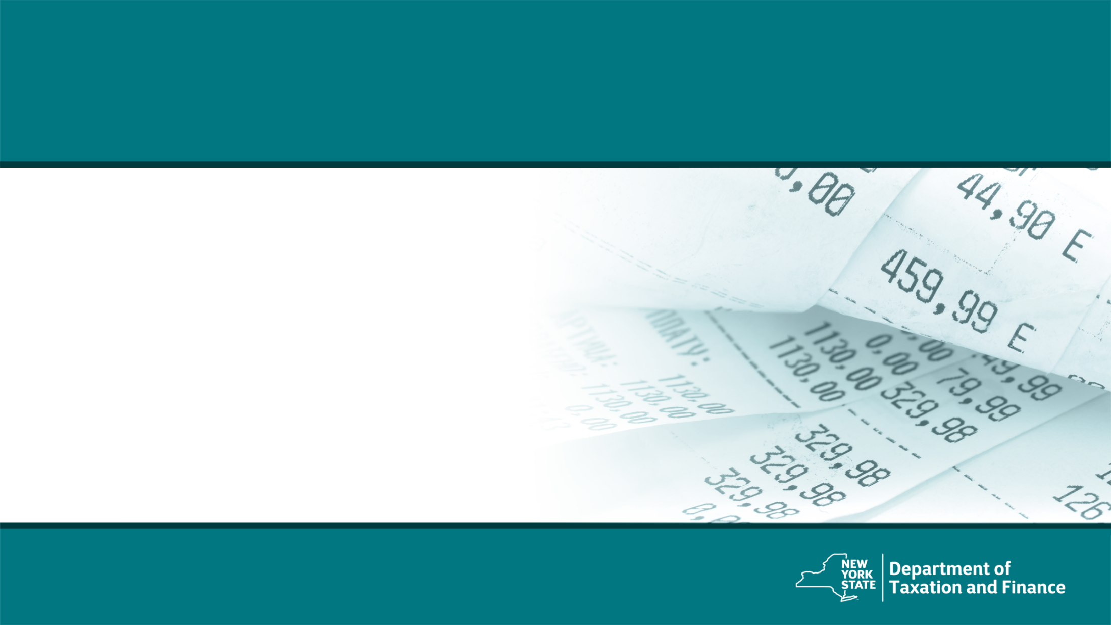
Federal Income and Adjustments
Notes:
Let’s start with income and adjustments.

Slide 40
Federal Income and Adjustments
The computation of New York State, New York City, and Yonkers income tax is based on the information reported on the federal income tax return, including income and federal adjustments to income.
Federal adjusted gross income (FAGI) is gross income minus adjustments to income.
Gross income includes wages, dividends, capital gains, business income, retirement distributions, as well as other income.
Notes:
The computation of New York State, New York City, and Yonkers income tax is based on the information reported on the federal income tax return, including income and federal adjustments to income.
Federal adjusted gross income (FAGI) is gross income minus adjustments to income.
Gross income includes wages, dividends, capital gains, business income, retirement distributions, as well as other income.

Slide 41
Addition and Subtraction Modifications
Notes:
Next we will discuss addition and subtraction modifications, first let’s explain why we have these modifications.

Slide 42
New York State Modifications
New York State taxes certain items of income not taxed by the federal government. Taxpayers must add these New York additions to FAGI.
Similarly, New York State does not tax certain items of income taxed by the federal government. Taxpayers must subtract these New York subtractions from FAGI.
New York adjusted gross income (NYAGI) is federal adjusted gross income after certain New York additions and New York subtractions (modifications).
Notes:
New York State taxes certain items of income not taxed by the federal government. Taxpayers must add these New York additions to FAGI.
Similarly, New York State does not tax certain items of income taxed by the federal government. Taxpayers must subtract these New York subtractions from FAGI.
New York adjusted gross income (NYAGI) is federal adjusted gross income after certain New York additions and New York subtractions (modifications).
For these additions and subtractions some items have their own line items on the return, but other items are included on the IT-225. The software will place them appropriately.

Slide 43
Form IT-225
New York State Addition and Subtraction modifications are generally reported on Form IT-225, New York State Modifications, unless specifically noted.
Notes:
New York State Addition and Subtraction modifications are generally reported on Form IT-225, unless specifically noted.
For these additions and subtractions some items have their own line items on the return, but other items are included on the IT-225. The software will place them appropriately.

Slide 44
Common New York State Additions
Public employee 414(h) retirement contributions
Interest income on state and local bonds
Net gain from casualty and theft loss
New York City flexible benefits program (IRC 125)
New York’s 529 college savings program distributions
Notes:
Some common new York state additions include:
Interest income on state and local bonds
Net gain from casualty and theft loss
Public employee 414(h) retirement contributions
New York City Flexible Benefits Program (IRC 125) amounts deducted or deferred from salary
New York’s 529 college savings program
Let’s go into these one at a time.

Slide 45
414(h) Retirement Contributions
Taxpayers who are a member of a public employee retirement system must report 414(h) retirement contributions as an addition modification to their FAGI on the New York State return.
Public employee retirement systems include:
New York State and Local Retirement System
New York City Retirement System
New York City Police Pension Fund
New York City Teachers Retirement System
Notes:
Regarding the 414H contributions and the IRC 125 flexible benefit programs:
Taxpayers must report 414(h) retirement contributions as an addition modification to their Federal Adjusted Gross Income (FAGI) on the New York State return. These contributions are related to the New York State and Local Retirement System; New York City Retirement System; New York City Police Pension Fund, or New York City Teachers Retirement System.

Slide 46
414(h) Retirement Contributions
414(h) retirement contributions are reported to the employee in box 14 on Form W-2.
This addition modification is reported on:
Line 21 of Form IT-201 (Residents), and
Line 21 of Form IT-203 (Nonresidents and Part-year Residents)
Notes:
Reported to the employee in box 14 on Form W-2.
414(h) pension contributions are added on line 21 of Form IT-201, Resident Income Tax Return and on line 21 of Form IT-203, Nonresident and Part-year Resident Income Tax Return.
(Line numbers verified – 2023 2022)

Slide 47
New York City Flexible Benefits Program (IRC 125)
Taxpayers who participate in a New York City flexible benefits program (IRC 125), must report the amount deducted or deferred from their salary as an addition modification.
This modification is for flexible benefits programs established by New York City or certain other New York City public employers.
Form IT-225 instructions includes a list of certain other New York City public employers.
Notes:
Taxpayers who participate in a New York City flexible benefits program (IRC 125), must report the amount deducted or deferred from their salary as an addition modification.
This modification is for flexible benefits programs established by New York City or certain other New York City public employers.
Form IT-225 instructions includes a list of certain other New York City public employers.

Slide 48
New York City Flexible Benefits Program (IRC 125)
IRC 125 benefit plan amounts are reported to the employee in box 14 on Form W-2.
This addition modification is reported on:
Line 23 of Form IT-201 (Residents), and
Line 22 of Form IT-203 (Nonresidents and Part-year Residents)
Notes:
New York City flexible benefits program are reported on Form IT-225, New York State Modifications, and then totaled with other additions and entered on line 23 of the IT-201 or line 22 of the IT-203.

Slide 49
Interest Income and Casualty and Theft Losses
Interest income on state and local bonds:
If from state and local bonds other than New York State or it’s local governments, addition modification must be made.
Net gain from casualty and theft loss:
New York itemized deduction for a casualty or theft that results in a net gain, addition modification must be made.
Notes:
For Interest income on State and local bonds
If the interest is from other than New York State or it’s local governments, an addition modification must be made.
For Net Gains from Casualty and Theft Loss
When there is a net gain on the New York itemized deduction for a casualty or theft, an addition modification must be made.

Slide 50
NYS 529 College Savings Plan Distributions
The New York State addback does not apply to withdrawals used for qualified education expenses.
If a nonqualified withdrawal was made from a NYS 529 college saving program, the taxpayer must complete the worksheets for IT-201, lines 22 and 30 of the New York return to compute the amount of any required amounts.
Notes:
The New York State addback does not apply to withdrawals used for qualified education expenses.
If a nonqualified withdrawal was made from a NYS 529 college saving program, the taxpayer must complete the worksheets for
IT-201, lines 22 and 30 of the New York return to compute the amount of any required amounts.

Slide 51
NYS 529 College Savings Plan Distributions
Qualified apprenticeship expenses are a qualified use of a 529 savings program.
Programs must be registered and certified with the Secretary of Labor.
The NYS Department of Labor (DOL) has a list of active apprenticeship programs in New York that would qualify.
Notes:
Since we are talking about non-qualified use of a 529 plan, you should know that the definition of eligible education institution under Subdivision 5 of Section 695-b of the education law was amended to include any apprenticeship program described in section 529 (c)(8) of the IRC.
So, it’s not just higher education, Qualified apprenticeship expenses are now a qualified use of a 529 savings program.
To qualify programs must be registered and certified with the Secretary of Labor. The Department of Labor has a list of active apprenticeship programs in New York that would qualify on their website.
We placed a link to that site in the Get Help section of our volunteer website.
Reference:
List of Active Sponsors | Department of Labor (ny.gov)

Slide 52
Common New York State Subtractions
Refunds, credits, or offsets of state and local income taxes
Qualified moving expense reimbursements or expenses
Interest on U.S. government bonds
New York 529 college savings program
deduction for student loans discharged due to death or disability
$20,000 pension/annuity exclusion for taxpayers 59½ or older
Pensions of New York State, local, or federal government employees
Notes:
Now let’s talk about subtractions. Some of the common New York State subtractions you may have seen in the past:
refunds, credits, or offsets of state and local income taxes
qualified moving expense reimbursements or expenses
interest on U.S. government bonds
New York 529 college savings program
$20,000 pension/annuity exclusion for taxpayers 59½ or older
pensions of New York State, local, or federal government employees
deduction for student loans discharged due to death or disability

Slide 53
New York State Modifications
Refunds, credits, or offsets of state and local income taxes
Qualified moving expense reimbursements and moving expenses
If a taxpayer received any qualified moving expense reimbursements or paid any moving expenses, there is a subtraction modification
Interest on U.S. government bonds
Notes:
For refunds, credits, or offsets of state and local income taxes
While these items are included in federal adjusted gross income (FAGI), New York allows a subtraction for them, so on our return they are in FAGI but then subtracted before determining New York adjusted gross income.
For qualified moving expense reimbursements and moving expenses
If a taxpayer received any qualified moving expense reimbursements or paid any moving expenses, there is a subtraction modification.
For Interest on U.S. government bonds
New York allows a subtraction for the interest.

Slide 54
NYS-529 College Savings Program
Contributions to a New York 529 college savings program may be deducted from federal income as a New York subtraction
Contributions are the amount contributed to the program up to $5,000 ($10,000 for married filing a joint return)
Only payments made during the taxable year can be claimed
Unclaimed amounts can not be carried forward to a future year
Taxpayer must be the owner of the account. If taxpayer contributes to an account owned by someone else, taxpayer cannot claim the subtraction.
Notes:
While we explained the addition modification that could be needed regarding NYS 529 plans, there is also a subtraction allowed for contributions to a NYS-529 College Savings Program. Contributions are the amount contributed to the program up to $5,000 ($10,000 for married filing a joint return). Only payments made during the taxable year can be claimed. Unclaimed amounts can not be carried forward to a future year. The taxpayer must be the owner of the account. If the taxpayer contributes to an account owned by someone else, the taxpayer cannot claim the subtraction.

Slide 55
New York State Income Modifications
Deduction for student loans discharged due to death or disability
For students or parent borrowers that had a student loan discharged in whole or in part due to death or disability, to the extent that the discharged amount was included in federal income, there is a subtraction modification.
Notes:
Deduction for Student Loans Discharged Due to Death or Disability
For students or parent borrowers that had a student loan discharged in whole or in part due to death or disability, to the extent that the discharged amount was included in federal income, there is a subtraction modification.
There are other student loan modifications for loan forgiveness that we will cover in a later section.

Slide 56
Discharged or Forgiven Student Loans
Student loans that were discharged or forgiven by any federally authorized program can be included as a subtraction modification if the amount was included in federal adjusted gross income.
Do not include any amount as a subtraction modification if it was not included in federal adjusted gross income.
Notes:
Student loans that were discharged or forgiven by any federally authorized program can be included as a subtraction modification if the amount was included in federal adjusted gross income.
Do not include any amount as a subtraction modification if it was not included in federal adjusted gross income.

Slide 57
Repayments of Income Reported in Prior Year
Generally, if a taxpayer included an item of income in the computation of NYAGI in a prior year and is then required to repay any of that previously taxed income in the current year, the amounts repaid in the current year may be deducted from current year income.
Notes:
A new provision was added to allow and adjustment for repayments of items of income reported in a prior year. Generally, if a taxpayer included an item of income in the computation of New York Adjusted Gross Income in a prior year and is then required to repay any of that previously taxed income in the current year, the amounts repaid in the current year may be deducted from current year income.
This adjustment would be made on the Form IT-225.

Slide 58
Student Loan Forgiveness Awards
Taxpayers will be allowed to subtract the amount of any student loan forgiveness award made by the state, including any awards made pursuant to a program established under Article 14 of the New York Education Law, to the extent the award was included in federal adjusted gross income.
Notes:
Taxpayers will be allowed to subtract the amount of any student loan forgiveness award made by the state, including any awards made pursuant to a program established under Article 14 of the New York Education Law, to the extent the award was included in federal adjusted gross income.
Typically loan forgiveness is considered taxable income.
There will be a subtraction modification on the IT-225 to reflect this exclusion and it should be used only if the loan forgiveness was included in federal taxable income.
For Reference Purposes only:
Subtraction Modification code S-142

Slide 59
Other Common NYS Subtractions
Taxable amount of social security and Tier 1 railroad retirement benefits
Military combat pay
Military pay (Form IT-203 filers only)
Disability income exclusion
Native American income exclusion
Notes:
As you can see there are a lot of New York subtractions. Here are a few more you may run into:
taxable amount of social security and Tier 1 railroad retirement benefits
military combat pay
military pay (Form IT-203 filers only)
disability income exclusion
Native American income exclusion
These are reported on the IT-225 and the instructions to the IT-225 explain them very well.

Slide 60
Pensions and Annuities Examples
Notes:
Some taxpayers incorrectly exclude pension income or take an excessive pension subtraction.

Slide 61
Pensions and Annuities
Two New York State subtractions for pension income:
Pensions of New York State, local governments within New York State, and the federal government – 100% subtraction
Pension and annuity income exclusion – up to $20,000 subtraction
taxpayer must be over the age of 59 ½
if the taxpayer turned 59 ½ during the tax year, the exclusion is only allowed for income received on or after they became 59 ½
Notes:
Some taxpayers incorrectly exclude pension income or take an excessive pension subtraction so this is an important area.
There are two New York State subtractions for pension income:
100% of pensions of New York State and local governments and the federal government can be excluded, or
the $20,000 pension and annuity income exclusion.
Be aware that deferred compensation or supplemental pension income is not fully excludable government pension income.
A pension or annuity subtraction may only be claimed if pension income was included in total income. And you should be aware that pension and annuity income includes the TY2022 income getting recognized from a qualified COVID distribution that was taken in TY2020 where the income was spread over 3 years.

Slide 62
Pensions and Annuities
If a taxpayer received pension income as a beneficiary and the decedent would have been 59½ if they continued to live, the beneficiary is eligible for an exclusion with certain limitations.
The exclusion must be prorated amongst all beneficiaries in the same ratio as the distribution is shared, even if not all beneficiaries are New York residents.
Notes:
If a taxpayer received pension income as a beneficiary and the decedent would have been 59½ if they continued to live, the beneficiary is eligible for an exclusion with certain limitations. The exclusion must be prorated amongst all beneficiaries in the same ratio as the distribution is shared, even if not all beneficiaries are New York residents.
I want to remind you that there is a pension subtraction handout which goes over the ins and outs of pensions on the website under training. It’s CO-60.

Slide 63
Pension Example 1
Married filing jointly
Spouse 1: age 59, received $30,000 from a government pension (NYS, local governments within NYS, and the federal government)
Spouse 2: age 60, received $10,000 from a private (non-government) pension
Total pension subtraction allowed = $40,000
NYS, local governments within NYS, and the federal government pensions qualify for the full exclusion regardless of age
Notes:
Total pension subtraction allowed = $40,000
New York State and local governments (of NYS) and the federal government plans qualify for full exclusion regardless of age.
Let’s look at some examples on how to enter the exclusion for taxpayer who qualifies for exclusion.

Slide 64
Pension Example 2
Married filing jointly
Spouse 1: age 52, received $35,000 from a government pension (NYS, local governments within NYS, and the federal government)
Spouse 2: age 52, received $15,000 from a private pension
Total pension subtraction allowed = $35,000
Spouse 2 does not qualify for the $20,000 pension and annuity income exclusion as they were not aged 59½ or older
Notes:
Married filing jointly
Spouse 1 - age 52. Received $35,000 in pension from public government job (federal, New York State, or New York State local government)
Spouse 2 - age 52. Received $15,000 from a private pension.
Total pension subtraction allowed = $35,000
Spouse 1 qualify for the full subtraction on the government plan
Spouse 2 doesn’t qualify for up to $20,000 since they were not ages 59½ or older.

Slide 65
Pension Example 3
Married filing jointly
Spouse 1: age 63, received $30,000 from a New Jersey (NJ) state pension
Spouse 2: age 58, received $10,000 from a private pension
Total pension subtraction allowed = $20,000
Pensions of states – other than New York State – are considered private plans. Spouse 1 does qualify for the $20,000 exclusion they were aged 59½ or older
Spouse 2 does not qualify as they were not aged 59½ or older

Slide 66
Pension Example 4
Head of household or single
Age 62, received $50,000 from a New York State pension
Received $30,000 from NYS Deferred Compensation Plan withdrawal
Total pension subtraction allowed = $70k
NYS Deferred Compensation Plan withdrawals qualify for the exclusion up to $20,000 as they were aged 59½ or older.
Notes:
Head of household or single
Age 62. Received $50k in pension from New York State job
Received $30,000 from New York State Deferred Compensation Plan withdrawal
Total pension subtraction allowed = $70k
New York State Deferred Compensation Plan is a private plan. The withdrawal qualify for up to $20,000 since they were ages 59½ or older.

Slide 67
Pension and Annuity Income Resources
Publication 36, General Information for Senior Citizens and Retired Persons.
Form CO-60, Common questions and answers about pension subtraction adjustments.
Notes:
Publication 36, General Information for Senior Citizens and Retired Persons, available on our website under Forms and Guidance
Form CO-60, Common questions and answers about pension subtraction adjustments.

Slide 68
New York State Standard and Itemized Deductions
Notes:
Once all the modifications to income are done, you have your New York adjusted gross income and we can now cover deductions

Slide 69
Standard and Itemized Deduction
The standard deduction is a specific dollar amount that reduces the amount of taxable income.
Some taxpayers choose to itemize their deductions if their total allowable itemized deductions is greater than their standard deduction.
Note: Taxpayers who are married and filing separate returns must both take the standard deduction unless both spouses choose to itemize their deductions.
Notes:
The standard deduction is a specific dollar amount that reduces the amount of taxable income.
Some taxpayers choose to itemize their deductions if their total allowable itemized deductions is greater than their standard deduction.
Note: Taxpayers who are married and filing separate returns must both take the standard deduction unless both spouses choose to itemize their deductions.

Slide 70
2024 Standard Deduction Table
Filing Status | Standard Deduction
Single (item C Yes) Single (item C No) | $3,100 $8,000
Married filing joint return | $16,050
Married filing separate return | $8,000
Head of household | $11,200
Qualifying surviving spouse | $16,050
Dependent exemption $1,000 per qualified dependent
Notes:
The 2024 standard deduction table is the same as last year.
Dependent exemption $1,000 per qualified dependent
No New York State personal exemption for the taxpayer and spouse allowed

Slide 71
New York Itemized Deductions
In general, New York itemized deductions are computed using the federal rules as they existed prior to the changes made by the federal Tax Cuts and Jobs Act.
Taxpayers can not use total federal itemized deduction as a starting point.
Taxpayers may itemize for the state, even if they use the standard deduction for their federal return.
Notes:
In general, New York itemized deductions are computed using the federal rules as they existed prior to the changes made by the Tax Cuts and Jobs Act. Taxpayers can not use total federal itemized deduction as a starting point. Taxpayers may itemize for the state, even if they use the standard deduction for their federal return.

Slide 72
New York Itemized Deductions Form
Form IT-196, New York Resident, Nonresident, and Part-Year Resident Itemized Deductions, and the instructions:
Walks taxpayers through the computation of New York itemized deductions.
For more information, visit www.tax.ny.gov (search: deductions).
Notes:
Itemized deductions are handled on Form IT-196, New York Resident, Nonresident, and Part-Year Resident Itemized Deductions:
This form Walks you through the computation of New York itemized deductions. And the software guides you though them as well, so we won’t go through these items in the training. For additional guidance, visit the www.tax.ny.gov (search: deductions).

Slide 73
Form 1099-G Information
Taxpayers may view and print Form 1099-G, Statement for Recipients of State Income Tax Refunds, directly from our website. The state do not mail Form 1099-G.
The 1099-G amount reflects the amount of state and local taxes a taxpayer overpaid through withholding or estimated tax payments.
For most taxpayers, the amount shown on their 2024 Form 1099-G is the same as the 2023 New York State income tax refund they actually received.
Notes:
RS: I do not agree with the last bullet; however, that what we received from Francine last year. Most of this audience would qualify for a tax credit, which would increase the amount of refund above the refund of taxes overpaid!
If taxpayers include taxes paid for itemizing, they may need their 1099-G information from New York State. You may view and print Form 1099-G, Statement for Recipients of State Income Tax Refunds, directly from our website. We do not mail Form 1099-G. The 1099-G amount reflects the amount of state and local taxes a taxpayer overpaid through withholding or estimated tax payments. For most people, the amount shown on their 2023 Form 1099-G is the same as the 2022 New York State income tax refund they actually received.

Slide 74
New York State Tax Credits
Notes:
Now that all the adjustments and deductions are complete, the taxpayer will have their New York taxable income and compute their tax due. However, they can reduce this tax due amount further with Tax Credits. While there are many New York State tax credits, we tried to concentrate on the ones you are most likely to see. If you do come across a credit that is not listed in this presentation, our website has designated web pages for each credit that can offer you clear explanations to assist you. First let’s discuss a new credit this year.

Slide 75
IT-213, Empire State Child Credit
This refundable credit is available to full-year New York State residents who have at least one qualifying child and meet certain income limits.
How much is the credit?
If a taxpayer claimed the federal child tax credit, the Empire State child credit is the greater of:
33% of the taxpayer’s allowed federal child tax credit and additional child tax credit (calculated using the federal credit amounts and income thresholds that were in effect for tax year 2017), or
$100 times the number of qualifying children, whichever is greater.
Notes:
First is the Empire State Child Credit.
How much is this credit, if taxpayer claimed the federal child tax credit, the Empire State child credit is generally the greater of 33% of the taxpayer’s allowable federal child tax credit or $100 times the number of qualifying children.

Slide 76
IT-213, Empire State Child Credit
To qualify for this credit, taxpayers must meet one of the following conditions:
have a federal child tax credit or additional child tax credit based on the income thresholds in effect for 2017, or
have federal adjusted gross income of:
Filing Status | Federal Adjusted Gross Income (FAGI)
Married filing a joint return | $110,000 or less
Single, or head of household, or qualifying surviving spouse | $75,000 or less
Married filing separately | $55,000 or less

Slide 77
IT-213, Empire State Child Credit
If a taxpayer does not claim the federal child tax credit but meets all the other eligibility requirements, the amount of the Empire State child credit is $100 multiplied by the number of qualifying children.

Slide 78
Qualifying Child
For purposes of the Empire State child credit, a qualifying child:
a child, stepchild, adopted child, foster child, sibling, stepsibling, half-sibling, or a descendant of any of them (for example, a grandchild, or a sibling’s child),
was under the age of 17 on December 31,
did not provide over half of their own support,
lived with the taxpayer for more than half of the year,
Notes:
I’ve included the eligibility requirements of a qualifying child for purposes of the Empire State child credit as a reference here. Similar to EIC, there must be a familial relationship, and the child lived with the taxpayer for more than half the year.

Slide 79
Qualifying Child (continued)
For purposes of the Empire State child credit, a qualifying child:
is claimed as a dependent on the taxpayer’s federal income tax return,
does not file a joint federal income tax return (or files it only to claim a refund of withholding or estimated tax paid), and
was a citizen, national, or resident noncitizen of the United States.
A valid Social Security number (SSN) or individual taxpayer identification number (ITIN) must be provided for each child claimed.

Slide 80
Additional Empire State Child Credit Payments
Additional $350 million in payments issued by check to more than 1.5 million taxpayers
Majority of payments issued in August and September 2024
Average payment of $233 per taxpayer
Payments do not need to be reported on the 2024 tax return
Visit www.tax.ny.gov (search: additional)

Slide 81
IT-215, Earned Income Credit (EIC)
EIC is a refundable tax credit that helps low – to moderate – income workers and families get a tax break.
Taxpayers are eligible for this refundable credit if they:
worked and earned less than $66,819, and
had investment income less than $11,600.
The amount of the credit depends on whether the taxpayer has children, dependents, are disabled or meet other criteria.
Taxpayers and any qualifying children must each have a valid social security number (SSN) by the due date of the tax return.
Notes:
Now on to the various credits. I want to start with the earned income credit because this is probably the largest credit that taxpayers can qualify for. Read slide:
EIC is a refundable tax credit for working taxpayers. This credit puts money directly into the pockets of working taxpayers, can be a financial lifeline for those struggling to make ends meet.
The investment income threshold increased so that Investment income can not be greater than $11,600.

Slide 82
IT-215, Earned Income Credit (EIC)
How much is the credit?
New York State EIC: is generally 30% of the federal credit EIC reduced by the amount of any household credit.
New York City EIC: the credit ranges from 10% to 30% of the federal EIC based on a taxpayer’s New York adjusted gross income.
Notes:
The credit is generally 30% of the allowable federal credit reduced by the amount of any household credit allowed.
Remember, The taxpayer must have claimed the federal earned income credit (EIC) for tax year 2023.

Slide 83
Qualifying Child
For purposes of the Earned Income Credit, a qualifying child must meet the following requirements:
Age: be under the age of 19, 24 if a full-time student, or any age if permanently disabled.
Relationship: be a child, stepchild, adopted child, foster child, sibling, half-sibling, step-sibling, grandchild, or your sibling’s child.
Residency: must live with the taxpayer in the U.S. for more than half the year.
Joint return: must not have filed a joint return with another person (ex: spouse) to claim any credits such as EIC.
Notes:
To claim a qualifying child for purposes of EIC, the child must meet the following requirements. I’ve included the link to the IRS website for the eligibility requirements of qualifying child.
Age: be under the age of 19, 24 if a full-time student, or any age if permanently disabled.
Relationship: there must be a familial relationship child, stepchild, or grandchild.
Must have lived with the taxpayer for more than half the year.

Slide 84
IT-209, Noncustodial Parent Earned Income Credit
This refundable credit can be claimed by noncustodial parents who are ineligible to claim the Earned Income Credit.
Noncustodial parents are the parent of a child (or children) who did not reside with them during the tax year.
Taxpayers and any qualifying children must have a valid social security number (SSN) by the due date of the tax return.
Notes:
Next is the Non custodial parent earned income credit. If a taxpayer does not qualify to claim the EIC, they may qualify for the Noncustodial Parent Earned Income Credit. On the previous slide, we mentioned that to be a qualifying child, the child have lived with the taxpayer for more than half the year. Noncustodial parents are the parent of a child (or children) who did not reside with them during the tax year, but they had to pay child support and meet other requirements.
And similar to EIC, taxpayers and any qualifying children must have a valid SSN by the due date of the return.

Slide 85
IT-209, Noncustodial Parent Earned Income Credit
Noncustodial parents are eligible to claim this credit if they:
did not claim the New York State earned income credit (EIC);
were a full-year New York State resident;
were at least 18 years of age;
are a parent of a minor child (or children) with whom they do not reside and are under the age of 18;
must have an order in effect for at least one-half of the tax year requiring child support payments be paid through a New York State Support Collection Unit (SCU); and
have paid an amount in child support during the tax year 2023.
Notes:
I’ve included the eligibility requirements for this credit. As I’ve mentioned, this credit is for a parent of a child with whom they did not reside, and the parent made required child support payments.

Slide 86
IT-209, Noncustodial Parent Earned Income Credit
How much is the credit?
20% of the federal EIC if the noncustodial child met the qualifying child definition, or
2.5 times the federal EIC, if eligibility requirements were met, calculated as if the taxpayer had no qualifying children, which ever is greater.

Slide 87
IT-214, Claim For Real Property Tax Credit
This credit is available to New York State residents who:
have household gross income of $18,000 or less,
occupied the same NY residence for six months or more, and
meet certain conditions as a homeowner or renter.
How much is the credit?
if all household members are under 65, the credit can be as much as $75
if at least one member of the household is 65 or older, the credit can be as much as $375
Notes:
Next up is the Claim for Real Property Tax Credit. This credit is available to New York State residents who:
Household gross income was $18,000 or less
Average rent was $450 or less
Must have paid real property taxes or rent on their residence
Market value of all real property owned was $85,000 or less
Must be a New York State resident for the entire year
Can’t be claimed as a dependent

Slide 88
IT-214, Claim For Real Property Tax Credit
Taxpayers must provide the Social Security numbers (SSN), and date of birth for each household member(s) claimed.
How to claim this credit:
this credit is claimed with a NYS personal income tax return
if a taxpayer is not required to file, the credit can be claimed on Form IT-214, Claim For Real Property Tax Credit within three years.
Example: 2024 credit claim can be filed after January 1, 2025, but no later than April 15, 2028.

Slide 89
IT-214 Definitions
Household members
Anyone who shares a residence and its furnishings, facilities, and accommodations, whether they are related or not.
Household gross income
Includes income from all sources the taxpayer and members of the household receive. It does not include food stamps, Medicare, Medicaid, scholarships, grants, surplus food, or other relief.
Notes:
Some key definitions for this credit:
Members of household
All who share your residence and its furnishings, facilities, and accommodations, whether they are related to you or not.
Household gross income
Income from all sources that you and members of your household receive. It does not include food stamps, Medicare, Medicaid, scholarships, grants, surplus food, or other relief.

Slide 90
IT-216, Child And Dependent Care Credit
This tax credit helps taxpayers pay for the care of qualifying children (and other dependents) and is fully refundable for NYS residents.
This credit can be claimed if qualified to claim the federal child and dependent credit (whether it was claimed it or not).
Child and dependent care expenses must be work related: allow taxpayers to work or look for work.
Notes:
Next is the child and dependent care credit, is a tax credit that may help you pay for the care of qualifying children and other dependents (which we all know can be very expensive)
The child and dependent care credit can be claimed if qualified to claim the federal child and dependent credit (whether it was claimed it or not). And this is a refundable credit for NYS residents.
Just note that child and dependent care expenses must be work related: meaning that they allow taxpayers to work or look for work.

Slide 91
IT-216, Child and Dependent Care Credit
How much is the credit?
The credit is computed based on the amount of your New York State adjusted gross income, the number of qualifying persons, and the amount of qualified expenses paid.
Note: Each person listed on the return must provide a valid Social Security number (SSN) or individual taxpayer identification number (ITIN).

Slide 92
IT-216, Child and Dependent Care Credit
Qualified expense limits based on the number of qualifying persons:
$3,000 for one,
$6,000 for two,
$7,500 for three,
$8,500 for four, and
$9,000 for five or more qualified persons.
Notes:
There are qualified expense limits based on the number of qualifying children shown here.

Slide 93
IT-216, Child And Dependent Care Credit
Child and dependent care expenses include, but are not limited to:
education: programs for children below kindergarten level
dependent care centers: place that provides care for more than 6 persons and complies with state regulations
transportation: transportation for the care of a qualifying person by a care provider (ex: bus, subway, taxi)
fees and deposits: fees paid to an agency to get care services
Notes:
Child and dependent care expenses include, but are not limited to:
Education: programs for children below level of kindergarten (nursery school, preschool)

Slide 94
IT-216, Child And Dependent Care Credit
New York City child and dependent care credit
Refundable for full-year New York City residents who paid child-care expenses for at least one child who was under age four on December 31.
Taxpayers must:
have federal adjusted gross income of $30,000 or less, and
be eligible to claim the New York State child and dependent care credit.
The credit can be as much as 75% of the New York State credit.
Notes:
There is also a NYC Child and Dependent Care Credit that is refundable for full-year NYC residents who paid child-care expenses for at least one child who was under age four on December 31.
Taxpayers must:
have federal adjusted gross income of $30,000 or less, and
be eligible to claim the New York State child and dependent care credit.
And this credit can be as much as 75% of the New York State credit.

Slide 95
IT-272, College Tuition Credit or Deduction
The college tuition credit or itemized deduction is allowed for qualified college tuition expenses paid for an eligible student.
College tuition credit: is limited to $400 per eligible student and to full-year NYS residents only.
College tuition itemized deduction: is for taxpayers who itemized their deductions on the NYS return, the maximum deduction is $10,000 for each eligible student.

Slide 96
IT- 272, College Tuition Credit or Deduction
Only expenses for undergraduate enrollment or attendance at an institution of higher education qualify.
Taxpayers may claim either the credit or the deduction, but not both.
If the college tuition credit is more than the tax for the tax year, the excess credit will be refunded without interest.
Notes:
The claim for college tuition credit.
Only qualified tuition expenses paid for undergraduate enrollment or attendance at an institution of higher education qualify for the credit. Up to $10,000 of tuition expenses per eligible student can be used to calculate the credit. Taxpayers can claim a 4% refundable credit or use the tuition expense amount as an added itemized deduction. For tuition expense under $5,000, the credit is the lesser of $200 or the tuition expense.

Slide 97
IT- 272, College Tuition Credit or Deduction
Expenses may be paid by cash, check, credit card, or with borrowed funds.
The eligible student does not need to be enrolled in a degree program or to attend full time for the expenses to qualify.
If the student is claimed as a dependent, these payments are treated as paid by the taxpayer.
Notes:
Expenses may be paid by cash, check, credit card, or with borrowed funds. The eligible student doesn’t need to be enrolled in a degree program or to attend full time for the expenses to qualify. If the student is claimed as a dependent, these payments are treated as paid by the taxpayer.

Slide 98
IT- 272, College Tuition Credit or Deduction
Qualified college tuition expenses do not include:
Graduate level tuition expenses
Tuition expenses that were paid by scholarships, grants and/or an employer
Amounts paid for:
room/board, insurance, medical expenses, and transportation;
course related books, supplies, or equipment; and
fees paid as a condition of enrollment, attendance, or non-academic activities
Notes:
Let’s review the college tuition credit or deduction. The qualified expenses for this credit and the itemized deduction are listed on the on the IT-272. However, a taxpayer can not take both the credit and the deduction. There is a worksheet included to help determine which is more beneficial. Do not claim the following as qualified expenses:
graduate-level tuition expenses
tuition expenses that were paid by scholarships, grants and/or an employer
expenses for:
room/board, insurance, medical expenses, and transportation;
course related books, supplies, or equipment; and
fees paid as a condition of enrollment, attendance, or non-academic activities

Slide 99
IT- 272, College Tuition Credit or Deduction
Do not claim:
Tuition expenses in a different tax year than they were paid
College tuition credit for someone who is not the taxpayer or a dependent
Be sure to provide:
The correct student SSN on Form IT-272, and
The correct college EIN on Form IT-272
Notes:
Additionally, do not claim tuition expenses in a different tax year than they were paid or a college tuition credit for someone who is not the taxpayer or a dependent. Remember, be sure to provide the correct student SSN and correct college EIN on Form IT-272.

Slide 100
IT-245, Claim For Volunteer Firefighter and Ambulance Worker Credit
$200 refundable credit or $400 if married filing jointly and both spouses qualify:
full-year resident; and
active volunteer firefighters or ambulance workers for the entire year for which the credit is claimed.
Use IT-201-ATT - Code 354 on line 12
If a taxpayer receives a real property tax exemption that relates to their volunteer service, they cannot claim the volunteer firefighters’ and ambulance workers’ credit.
Notes:
The claim for volunteer firefighter and Ambulance worker credit is a $200 refundable credit or $400 if married filing jointly and both spouses qualify. The taxpayer must be a full-year resident and active volunteer firefighters or ambulance workers for the entire year for which the credit is claimed. Use IT-201-ATT - Code 354 on line 12. If a taxpayer receives a real property tax exemption that relates to their volunteer service, they cannot claim the volunteer firefighters’ and ambulance workers’ credit.

Slide 101
IT-249, Claim for Long-Term Care Insurance Credit
This credit is for premiums paid for qualified long-term care insurance policies.
The credit is equal to 20% of the premiums paid during the tax year for the purchase of or for continuing coverage under a qualifying long-term care insurance policy.
Notes:
The claim for long term care insurance credit is for premiums paid for qualified long-term care insurance policies. The credit is equal to 20% of the premiums paid during the tax year for the purchase of or for continuing coverage under a qualifying long-term care insurance policy.

Slide 102
IT-249, Claim for Long-Term Care Insurance Credit
Health and life insurance don’t qualify.
Credit is only available to taxpayers with a NYAGI less than $250,000.
The credit amount cannot exceed $1,500 per return.
Notes:
Remember, health and life insurance premiums do not qualify for the credit. The credit is only available to taxpayers with NYAGI of less than $250,000 and is capped at $1,500 per return for taxable years beginning on or after January 1, 2020

Slide 103
IT-258, Refundable Nursing Home Credit
Available for amount of assessment imposed on a residential health care facility.
The assessment must be separately stated and must be paid directly by the individual taxpayer claiming the credit.
Credit equals the assessment amount (not expenses) separately stated and accounted for on the billing statement.
Use IT-201-ATT - Code 258 on line 12 or IT-203-ATT - Code 258 on line 12.
Notes:
The refundable nursing home credit is available for the amount of assessment imposed on a residential health care facility.
The assessment must be separately stated and must be paid directly by the individual taxpayer claiming the credit. The credit equals the assessment amount (not expenses) separately stated and accounted for on the billing statement. Use IT-201-ATT - Code 258 on line 12 or IT-203-ATT - Code 258 on line 12.

Slide 104
IT-267, Geothermal Energy Systems Credit
For qualified geothermal energy system equipment and expenditures installed at residential property located in New York state and placed in service after January 1, 2022.
To qualify, the property where the geothermal system is installed must be the taxpayer's residence at the time the system is originally placed in service.
The credit is equal to 25% of the qualified geothermal energy system expenditures and is limited to $5,000.
Notes:
We have one new credit that you might see this year. The Geothermal energy systems credit.
This new credit is for qualified geothermal energy system equipment and expenditures installed at residential property located in New York state and placed in service after January 1, 2022.
To qualify for the credit, the property where the geothermal system is installed must be the taxpayer's residence at the time the system is originally placed in service.
The credit is equal to 25% of the qualified geothermal energy system expenditures and is limited to $5,000.

Slide 105
IT-267, Geothermal Energy Systems Credit
Taxpayers can not claim the credit if the residential property is rented at any time during the year in which the credit is claimed.
Credit is allowed for leased systems but only for the first 15 years.
For cooperative housing corporation or a condominiums, a percentage of the qualified geothermal energy system equipment expenditures may be attributed to each unit within the building.
See Form IT-267, Geothermal Energy System Credit.
Notes:
If the residential property is rented at any time during the year in which the credit is claimed, you may not claim this credit
Taxpayers may only claim the credit for one geothermal energy system in a tax year. (Note: credit is allowed for leased systems but only for the first 15 years.)

Slide 106
Other Non-Automatic New York Credits
Notes:
RS: Many need new screenshot when 2024 software is available
Review the other New York refundable credits section before exiting state return.

Slide 107
Partner and Volunteer Filing Reminders
Notes:
Now that we have gone over the basics of the return and some of the common credits, it is time to finish it up so the return can be e-filed.

Slide 108
New York State and Local Sales Tax
New York State sales tax is owed if the taxpayer purchased property or a service delivered to them in New York State without payment of sales and use tax.
This includes purchases through the internet, by catalog, or from shopping channels on the television.
Most tangible personal property is subject to tax.
Do not leave the line blank.
Do not set software to auto fill with zero amount.
Notes:
You must ask taxpayers if they have any sales tax owed. New York State sales tax is owed if the taxpayer purchased property or a service delivered to them in New York State without payment of sales and use tax. This includes purchases through the internet, by catalog, or from shopping channels on the television. Most tangible personal property is subject to tax. Do not leave the line blank. Do not set software to auto fill with zero amount.

Slide 109
Refund Allocation to NYS 529 Accounts
Form IT-195, Allocation of Refund, allows taxpayers to allocate all or a portion of their refund into up to three New York State 529 College Savings Plan accounts.
If a refund claim is reduced or denied, the disbursements to NYS 529 plans will not be processed.
Notes:
Towards the end of the return filing there will be questions to see if taxpayers want to allocate all or a portion of their refund into up to three New York State 529 College Savings Plan accounts. This is for Form IT-195, Allocation of Refund. Please note that if a refund claim is reduced or denied, the disbursements to the NYS-529 will not be processed.

Slide 110
Enter Date of Birth
Enter the date of birth if the form requires this information.
It is used to determine eligibility, credits, exemptions, and deductions.
If not provided, the tax return may be rejected, or the taxpayer may receive a Request for Information (RFI) letter.
Notes:
It is used to determine eligibility, credits, exemptions, and deductions.
If not provided, the tax return may be rejected, or the taxpayer may receive a Request for Information (RFI) letter. This could lead to credits and refund amounts being adjusted or denied.

Slide 111
EITC Dependent Relationships
Relationship information added back to forms:
IT-215, Claim for Earned Income Credit, and
IT-209, Claim for Noncustodial Parent New York State Earned Income Credit.
Notes:
In addition, make sure to include relationship information. This information is included on forms IT-215, Claim for Earned Income Credit and IT-209, Claim for Noncustodial Parent New York State Earned Income Credit.

Slide 112
Amended Returns and Attachments
We treat an amended return as if it is an original return. All schedules and credit forms must be attached to the amended return.
All attachments for original or amended returns must be in PDF format.
Software should provide assistance.
Don’t password protect, encrypt, or in any way document-protect PDF attachments.
Notes:
With regard to attachments to returns:
They must be in PDF format.
Your Software should provide assistance on how to attach.
Don’t password protect, encrypt, or in any way document-protect PDF attachments.

Slide 113
Print All Worksheets
For both the federal and New York State returns, worksheets must be completed to support the information on a return.
A copy of the return should be printed and maintained for at least three years. It’s important that all worksheets be printed and kept with a copy of the return.
Taxpayers must maintain all documents that substantiate entries on a return. Worksheets are part of their supporting documentation.
Notes:
For both the federal and New York State returns, worksheets must be completed to support the information on a return. A copy of the return should be printed and maintained for at least three years. It’s important that all worksheets be printed and kept with a copy of the return. Taxpayers must maintain all documents that substantiate entries on a return. Worksheets are part of their supporting documentation.

Slide 114
Unreported Federal Changes
Taxpayers must file an amended New York State return to report any changes made to their federal return within 90 days of the federal change.
Even if the item of omission is not taxable to New York State, it should be included on an amended return since it could result in reductions to itemized deductions and credits.
If New York State issues a bill for unreported federal changes, an amended return should not be filed. Follow the instructions on the billing notice.
Notes:
It’s important to mention to your clients that Taxpayers must file an amended New York State return to report any changes made to their federal return within 90 days of the federal change. Even if the item of omission is not taxable to New York State, it should be included on an amended return since it could result in reductions to itemized deductions and credits. If New York State issues a bill for unreported federal changes, an amended return should not be filed. Follow the instructions on the billing notice instead.

Slide 115
2024 Questions and Answers
Notes:
Some taxpayers incorrectly exclude pension income or take an excessive pension subtraction.

Slide 116
E-file NY Amended Returns: Question
Will TaxSlayer software offer the option for New York State amended returns to be e-filed this year?

Slide 117
E-file NY Amended Returns: Answer
The New York State amended e-file user experience is actively being worked on by TaxSlayer’s development team and is expected to be available for the 2025 filing season.

Slide 118
Request an IPA in TaxSlayer: Question
If a taxpayer is unable to pay their tax bill in full by the due date, can we request an installment payment agreement (IPA) for the taxpayer by selecting Special Condition Code C2 in TaxSlayer’s drop-down menu basic information section?

Slide 119
Request an IPA in TaxSlayer: Answer
No, Special Condition Code C2 will only allow a taxpayer to more quickly receive a bill for the unpaid tax due.
After receiving the bill, the taxpayer may request an IPA using Online Services, through our phone system, or by speaking with a representative.
The Special Condition Code does not automatically create an IPA.
Notes:
No, the Special Condition Code C2 for bills to be generated sooner when a taxpayer reports a balance due on their return.
When a taxpayer filed a return before the filing deadline and the return shows a balance due without remitting full payment, and the department agrees with that balance due, the return enters a “pending state” without issuing the bill until the due date has passed. This is because the taxpayer has until that filing deadline to make full payment before penalties and interest start accruing.
The C2 code allows us to bypass pending state which allows us to generate a bill immediately (takes about 2 weeks for the bill to be generated and mailed). Once the taxpayer has received the bill, they can then request the IPA.
No IPA can be set up before the bill has been generated.

Slide 120
Tax Department Notices and Protest Rights
Notes:
Finally, let’s go over some key information on department programs and initiatives.

Slide 121
Request For Information Letter (RFI)
Form DTF-948 or DTF-948-O, Request for Information (RFI), is used to request information about a return.
It’s important to respond by the date on the letter so we can continue processing the return.
Common reasons we send RFI letters include:
validating wages and withholding
verifying if a taxpayer lived or worked in NYS, NYC, or Yonkers
confirming eligibility for credits
Notes:
If your client received a letter asking for missing information or documentation to support what was claimed on the tax return, it doesn't mean the taxpayer or tax professional did anything wrong. It's just an extra step we take to ensure refunds—for the correct amounts—go out to only those who are entitled to them. Our goal is to stop questionable refunds before they go out the door, not to delay your refund.
It’s important to respond by the date on the letter so we can continue processing the return.
Common reasons we send RFI letters include:
validating wages and withholding
verifying if a taxpayer lived or worked in NYS, NYC, or Yonkers
Confirming eligibility for credits

Slide 122
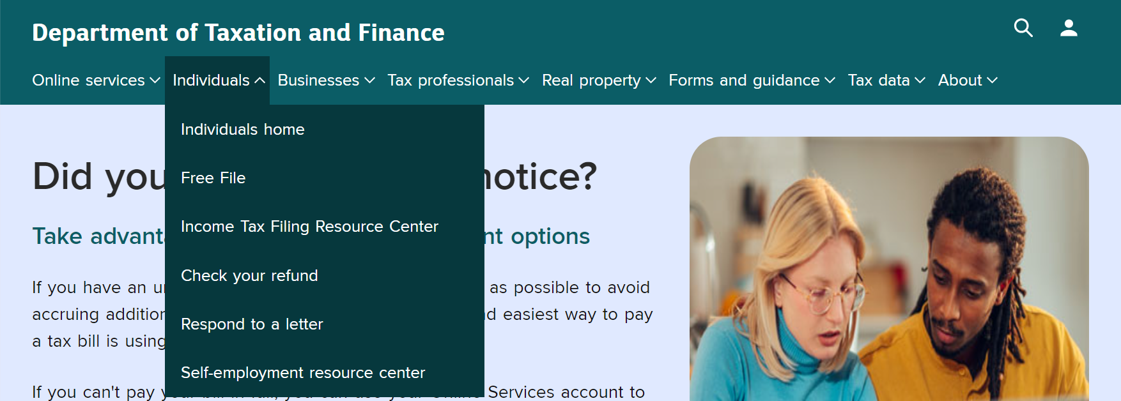
Respond To A Letter
www.tax.ny.gov
Notes:
Visit our webpage www.tax.ny.gov and select Individuals from the top, then select Respond to a letter. This page has helpful information on the notices that we send requesting additional information and how to respond to a notice.

Slide 123
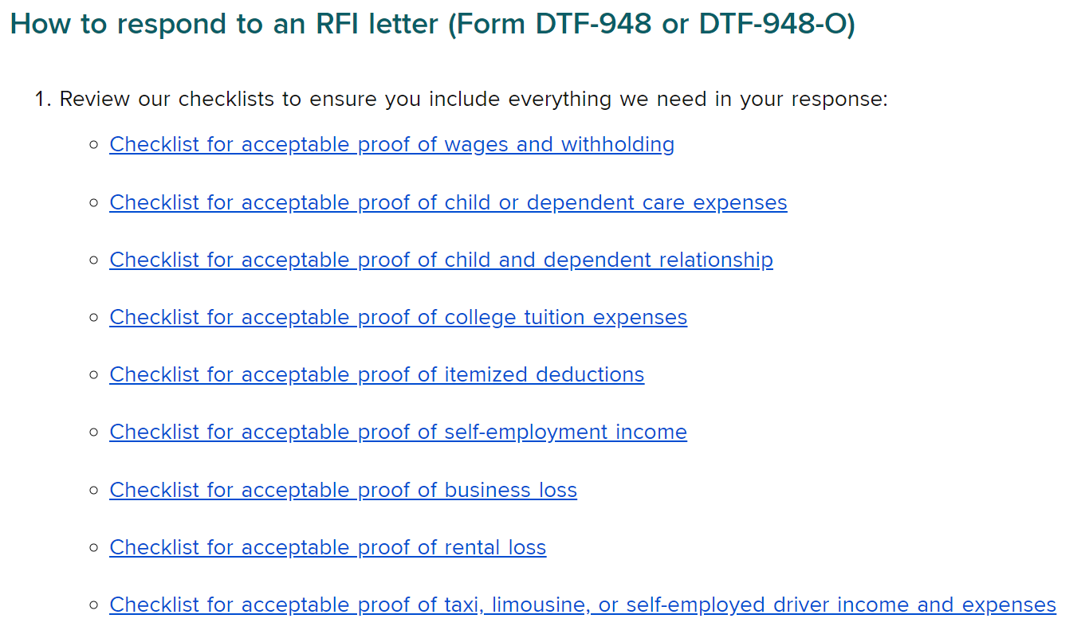
Respond To A Letter: Checklists
Notes:
Keeping good records an important part of our tax filing responsibilities. Generally, taxpayers must keep records and supporting documents for at least three years after a return is filed. These records document what is claimed on the tax return, including:
all sources of income,
the total of any withholding and estimated tax payments made, and
the expenses that may be entitled to deduct.
Our Respond to a letter website has helpful checklist to ensure taxpayers have everything they need for a response.

Slide 124
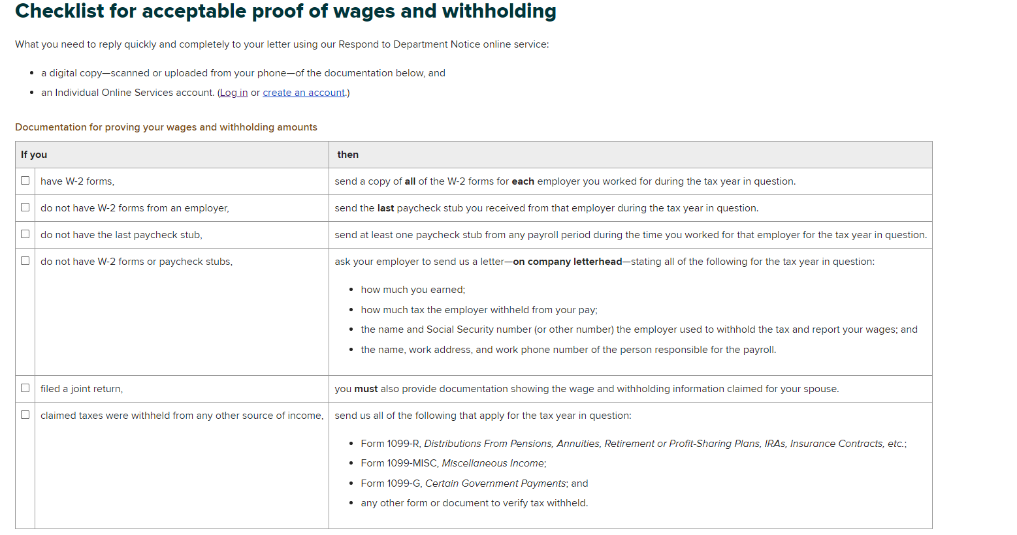
Respond To A Letter: Checklists
Notes:
Here’s an example checklist of acceptable proof of wages and withholding

Slide 125
Respond To Department Notice
The online Respond to department notice application is the easiest and fastest way to provide additional information.
Taxpayers can respond through an Individual Online Services account.
Tax Professionals can respond through a Tax Professional Online Services account.
Visit www.tax.ny.gov (search: respond)
Notes:
The easiest and fast way to respond to a notice is through the online Respond to a department notice application

Slide 126
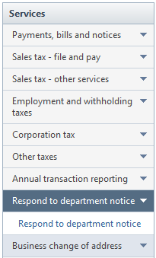
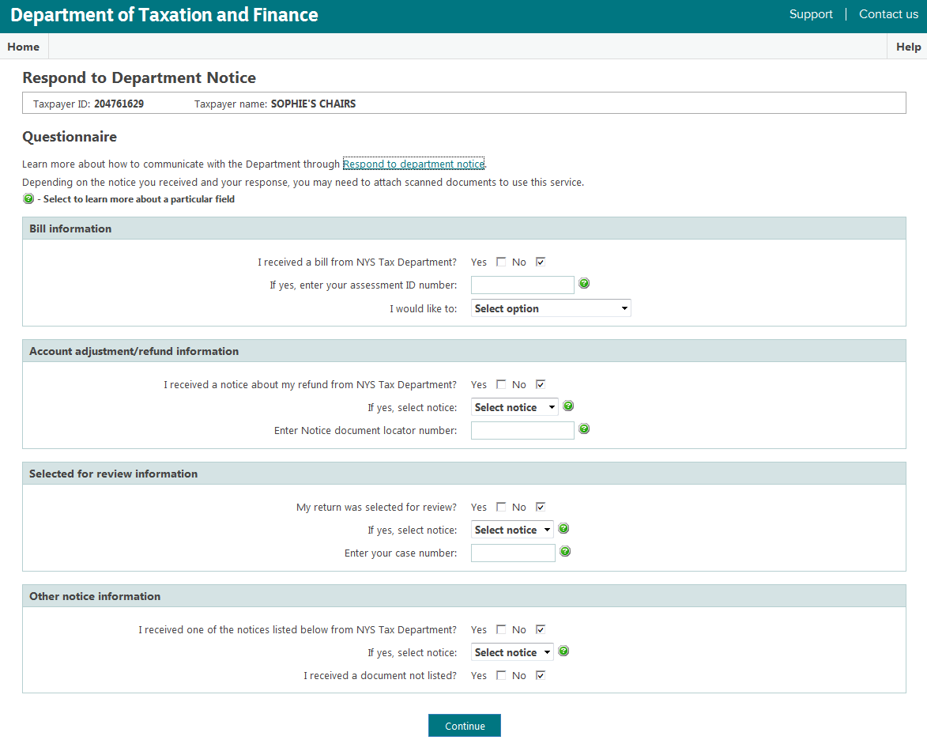
Respond to Department Notice
Visit: www.tax.ny.gov, (search: ols)
Notes:
Online Service (OLS) is a quick and easy way to respond is through their online account. This application is in the Services sidebar. Taxpayers should fill out:
the fields that relate to the notice, and
their response to the notice.
Taxpayers may need to attach scanned documents.

Slide 127
Protest A Department Notice
Certain Tax Department notices have protest rights where the taxpayer can challenge the notice in either of the following ways:
file a request for a conciliation conference (Form CMS-1), or
file a petition for a Tax Appeals hearing (Form TA-100).
A conciliation conference through the Bureau of Conciliation and Mediation Services (BCMS) is more timely and less expensive than a Division of Tax Appeals hearing.
Taxpayers initially file more than 98% of all protests as a request for a conciliation conference. Over 90% of these protests are resolved through this process.
Notes:
Certain Tax Department notices have protest rights where the taxpayer can challenge the notice in either of the following ways:
file a request for a conciliation conference (Form CMS-1), or
file a petition for a Tax Appeals hearing (Form TA-100).
A conciliation conference through the Bureau of Conciliation and Mediation Services (BCMS) is more timely and less expensive than a Division of Tax Appeals hearing. Tax Appeals is a more formal process before an administrative law judge who will make a determination in the case.
Taxpayers initially file more than 98% of all protests as a request for a conciliation conference. Over 90% of these protests are resolved through this process.

Slide 128
Protest Rights
The most common types of notices with protest rights are:
Notice of Determination (additional tax due)
Notice of Deficiency (additional tax due)
Notice of Disallowance (refund denial)
Notices are sent via certified mail to the last known address.
The protest date is generally 90 days from the mail date of the notice for assessments, and 2 years from the date of the notice for refund denials.
this cannot be extended!
For more information, visit www.tax.ny.gov (search: protest).
Notes:
Certain notices come with protest rights. The most common types of notices with protest rights are:
Notice of Determination (additional tax due)
Notice of Deficiency (additional tax due)
Notices are sent via certified mail to the last known address, which is why it is important to verify the taxpayer’s address.
The protest date is 90 days from the mail date of the letter. This date cannot be extended.
For more information, visit www.tax.ny.gov (search: protest).

Slide 129
Tax Department Programs and Initiatives
Notes:
Finally, let’s go over some key information on department programs and initiatives.

Slide 130
Tax Department Website
www.tax.ny.gov
Notes:
Our website is a resource for taxpayers. Choose helpful inks from the top of our page including Individuals and Forms and guidance.
In the upper right-hand corner, taxpayers can Log in or Create an Online Services account.

Slide 131
Individual Online Services Account
View filing and payment history;
Manage estimated income tax payments;
Choose to receive bills, notices, and refund notifications electronically;
Pay bills and respond to notices; and
Eliminate phone calls and hold time.
Notes:
Please remind taxpayers that they can Get access to their tax information whenever they need it by using an individual online services account. Here they can:
View filing and payment history
Manage estimated income tax payments.
Choose to receive bills, notices, and refund notifications electronically.
Pay bills and respond to notices, and.
Eliminate phone calls and hold time.

Slide 132
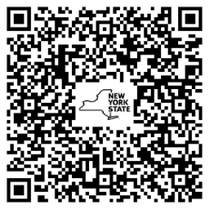
Interpretation Services
The Tax Department offers free interpretation services. For assistance call:
518-453-8137
To access web content available in Spanish, visit:
www.tax.ny.gov/language/espanol/
or scan this QR code:

Slide 133
Direct File Pilot: Tax Year 2023
Almost 13,000 New Yorkers filed their 2023 state returns using Direct File in a limited pilot program
95% satisfaction rate with Direct File
95% found the data transfer from the IRS “seamless and quick”
86% filed their state tax return in 15 minutes importing federal data
93% preferred Direct File over their previous filing method
Notes:
Approved SETP slide:

Slide 134
Direct File: Tax Year 2024
Expanded scope and availability
Retirement income
Child and dependent care credit (IT-216)
Real Property Tax Credit (IT-214)
For more information, visit the Tax Department website www.tax.ny.gov (search: direct file)
Notes:
Approved SETP slide:

Slide 135
Installment Payment Agreements (IPA)
Use self-service options to request an IPA.
Taxpayers must be current with tax filings, have no more than one prior IPA defaults, and no open collection, bankruptcy, or formal protest case.
Balances must be $20,000 or less, with a repayment term of no more than 36 months.
Select Installment payment agreement within OLS; must add required direct payment information; or use our automated phone system (requires a PIN number) to establish plan and set up payment later.
Notes:
Balances must be below $20,000 with a repayment term of less than 36 months.
Nearly 1/3 of IPAs set up by speaking with a representative are eligible to use the OLS or automated phone options

Slide 136
Report Identify Theft
Visit our website: www.tax.ny.gov (search: identity theft).
Complete Form DTF-275, Identity Theft Declaration
fax documents to 518-435-2990 Attention: Identity Theft
mail to: Identity Verification Unit
PO Box 4128 Binghamton, NY 13902-4128
Call 518-485-6549 for more information.

Slide 137
Identity Theft
Submit IRS Form 14039, Identity Theft Affidavit
Report to the Federal Trade Commission at www.identitytheft.gov
Contact credit bureau to place “fraud alert” on credit record
Equifax: 800-685-1111
Experian: 888-397-3742
TransUnion: 888-909-8872
Notes:
Some other recommendations for taxpayers are to:
Submit IRS Form 14039, Identity Theft Affidavit
Contact the Federal Trade Commission at www.identitytheft.gov
Contact credit bureau to place “fraud alert” on credit record
Equifax: 800-685-1111
Experian: 888-397-3742
TransUnion: 888-909-8872

Slide 138
Taxpayer Rights Advocate
Provides free and independent New York State tax problem assistance.
Ensures that the taxpayer’s New York State tax issue is reviewed in a timely manner.
Helps the taxpayer understand important notices and deadlines.
Explains taxpayer rights and responsibilities under the New York State Tax Law.
Helps resolve long-standing tax issues.

Slide 139
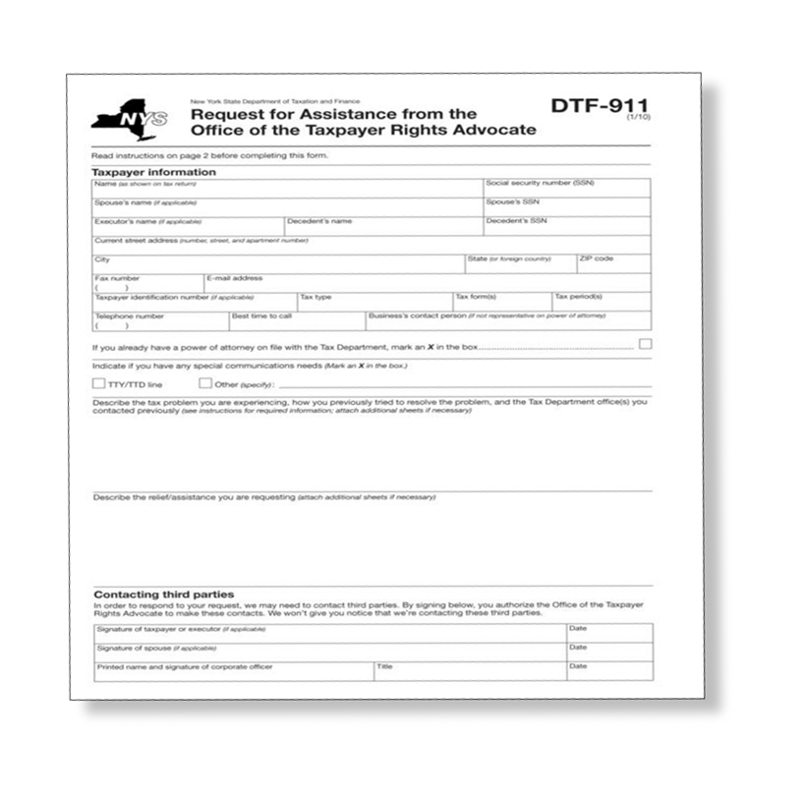
Get Help From the Advocate
The Office of the Taxpayer Rights Advocate (OTRA) works with taxpayers and the Tax Department to find issue resolution.
For assistance:
complete Form DTF-911
fax or mail to department
You will be assigned an advocate.
From www.tax.ny.gov (search: otra)
Call: 518-530-4357

Slide 140
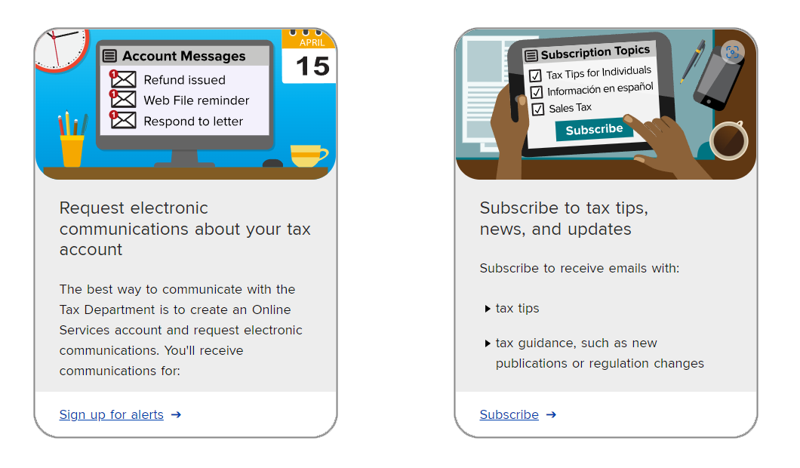
Subscription Services
www.tax.ny.gov (search: subscribe)

Slide 141
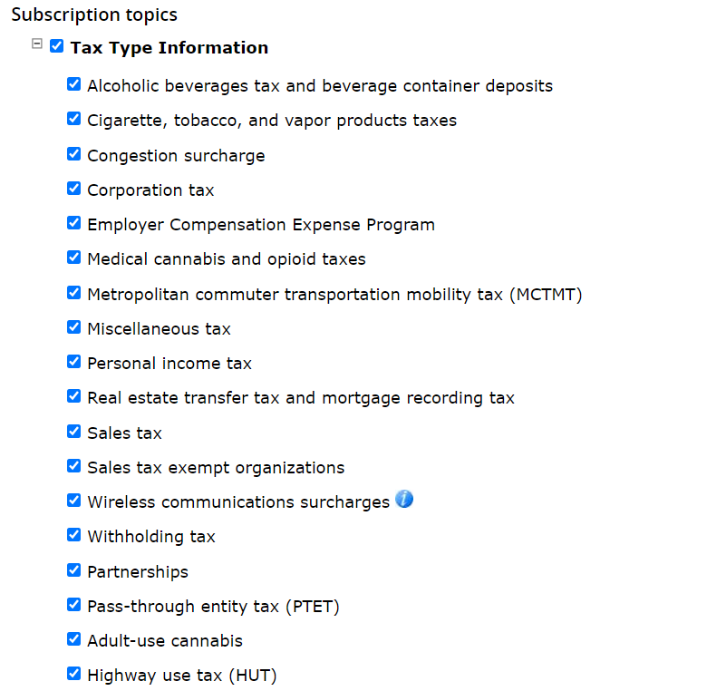
Subscription Services
Subscribe to receive emails with:
tax tips
tax guidance, such as new publications or regulation changes
filing updates and reminders
press releases and upcoming events

Slide 142
Efficiency
● Integrity
● Fairness
Notes:
We covered a lot with this training, I hope it will help you to help others with filing their 2021 tax returns. Thank you again for all that you do to help the taxpayers of the state of New York.

